Slide 1

INTERNSHIP PRESENTATION ON LIBRARY MANAGEMENT SYSTEM USING FULL STACK WEB DEVELOPMENT
JSS Mahavidyapeetha
JSS Academy of Technical Education
Kengeri - Uttarahalli Main Road, Bangalore-560060
DEPARTMENT OF COMPUTER SCIENCE & ENGINEERING
By:
BABITHA RANI B -1JS20CS040
BHAGYASHRI SHETTY H -1JS20CS043

Slide 2
ABSTRACT
Web development is the work involved in developing a web site for the internet (World Wide Web) or an intranet (a private network) web development can range from developing a simple single static page of plain text to complex web-based internet services.
Web Based College Internship System) is a comprehensive toolkit for managing and coordinating internship programs in an educational institution.
College Internship System was developed with the intension of providing an interactive tool for the faculty and students to communicate with each other whenever and wherever they want to. Students can understand the requirements and view their progress and interact with the faculty in a better way.

Slide 3
INTRODUCTION
Aim of the Project
Karna is an Engineering student who is currently in his 1st year. A typical day in his life includes attending his courses, following up on assignments and borrowing books from library to study. He finds it hard to remember the issue date of the book, no proper information about new stock and the antique method of book issuing doesn’t help him. Recently he learns from his classmate about a college which as online system of library management.
Karna really hopes his college could come up with a more organised and professional technique to regulate such opportunities so that all the students are intimated whenever a new books comes up.
Purpose of the Project
The Main purpose of this project is to design, build and implement a library management system with anytime and anywhere access availability. Project is to provide an easy-to-use interface for students and library members to interact with each other during the course of a student.

Slide 4
About the Project
The proposed project is a Library Management System for a College or a University.
Its role is assisting with books from a College or a University. It is a simple user interface which has two types of users: librarian and students. The Library Management system can be used to keep track of book issued date, last date , new stock, number of books issued. This system results in a systematic and organized grouping of data. Thus, with the help of this system the librarian have complete idea of every students complete record.
Objectives of the Project:
Learn About the Management
Learn New Skills
Professionally
Get Constructive Feedback
Establish Yourself Professionally

Slide 5

COMPANY PROFILE
Corporate Name: PRINSTON SMART ENGINEERS
Main Office: Vishnuvardhan Statue Rd, Vishwa Priya Nagar, Begur, Bengaluru, Karnataka 560068
Phone: +91 9810 188 747
Contact Person: Mrs. Fraheen Farhath(Managing Director)
Email Address: Prinston.Smart@gmail.com
Year Stand Up: 2004
Company Category: IT Software/Embedded

Slide 6
TRAINING CONTENT
FRONT-END TECHNOLOGIES
HTML - Hyper Text Markup Language
Hypertext Mark-up Language (HTML) is the standard mark-up language for documents designed to be displayed in a web browser. Web browsers receive HTML documents from a web server or from local storage and render the documents into multimedia web pages.
CSS - Cascading Style Sheets
Cascading Style Sheets (CSS) is a style sheet language used for describing the presentation of a document written in a markup language such as HTML. CSS is a cornerstone technology of the World Wide Web, alongside HTML and JavaScript.CSS is designed to enable the separation of presentation and content, including layout, colours, and fonts.
BOOTSTRAP
Bootstrap is a free and open-source CSS framework directed at responsive, mobile-first front-end web development. It contains CSS- and (optionally) JavaScript-based design templates for typography, forms, buttons, navigation, and other interface components
JAVASCRIPT
JavaScript often abbreviated as JS, is a high-level language, just-in-time compiled, object- oriented programming language that conforms to the ECMAScript specification

Slide 7
BACK-END TECHNOLOGIES
XAMPP
XAMPP is a free and open-source cross-platform web server solution stack package developed by Apache Friends, consisting mainly of the Apache HTTP Server, MariaDB database, and interpreters for scripts written in the PHP and Perl programming languages.
MYSQL
MySQL is multithreaded, multi user SQL database management System (DBMS). The basic program run as server providing multiuser access to a number of databases. MySQL is a database. The data in a MySQL is stored in a Database objects called tables. A table is a collection of related data entries and it consists of columns and rows.
PHP
PHP code may be executed with a command line interface (CLI), embedded into HTML code, or used in combination with various web template systems, web content management systems, and web frameworks.

Slide 8
REQUIREMENT SPECIFICATION
The system requirement and specification of our project is as follows:
Hardware Requirements
Processor: i5 Core Processor
Monitor: 1024 * 768 Resolution Colour
Keyboard: QWERTY RAM: 1 GB
Motherboard: 845c Intel Motherboard
Backup Media: Floppy/pen drive/Hard disk.
Hard disk: 2 TB HDD
I/O Device: Standard input and output devices.
Software Requirements
MySQL Libraries
Xampp software: Apache Server
Operating system: Windows 10

Slide 9
IMPLEMENTATION
We have implemented the following functionalities in the project :-
• ADMIN Side Functionalities:
1.Admin must be able to view the list of students Department Wise.
2. Admin must be able to add a new books into the database.
3. Delete student records based on their Graduation Year.
• STUDENT Side Functionalities:
1. Check the new books available.
2. Check all the details of cost per book .
3. Create a view with ID.
4. Students must be able to check which books they have borrowed.

Slide 10
FRONT END TASKS
1. Create member login page.
2. Create the landing page in both librarian and Student accounts.
3. Create All the necessary pages for each link and the functionalities.
4. Style all the Web pages.
CONNECTION
1. Implement the functionalities for each of the web page.
2. Use the appropriate Query for the functionalities.
3. Follow the same procedure –
- Create a SQL Template.
- Prepare the statement.
- Bind the parameters if required.
- Execute the statement.

Slide 11
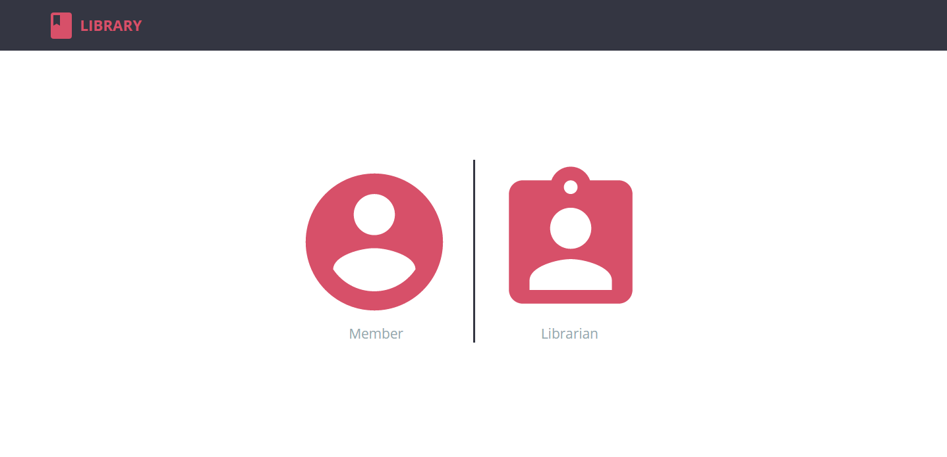
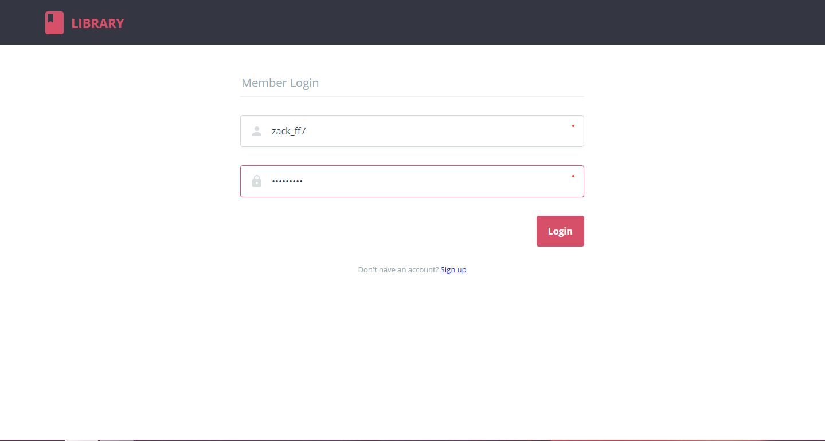
SNAPSHOTS
fig: home page
Fig: member login

Slide 12
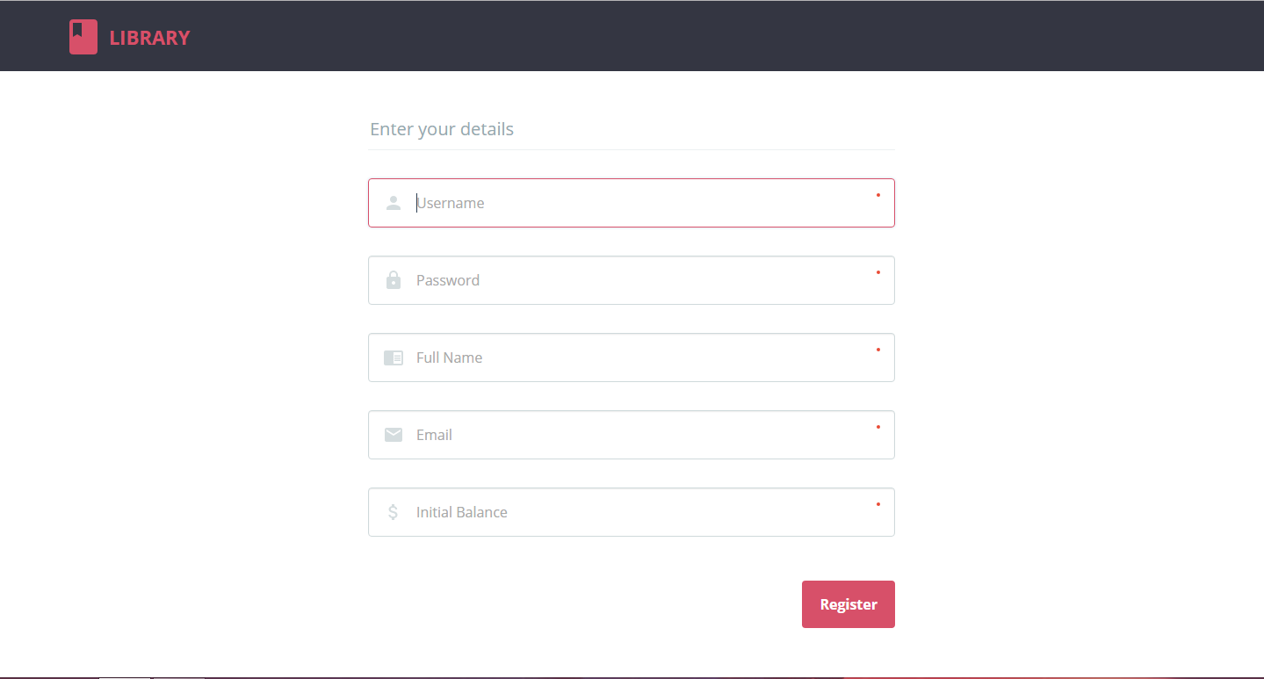
Fig: member registration1

Slide 13
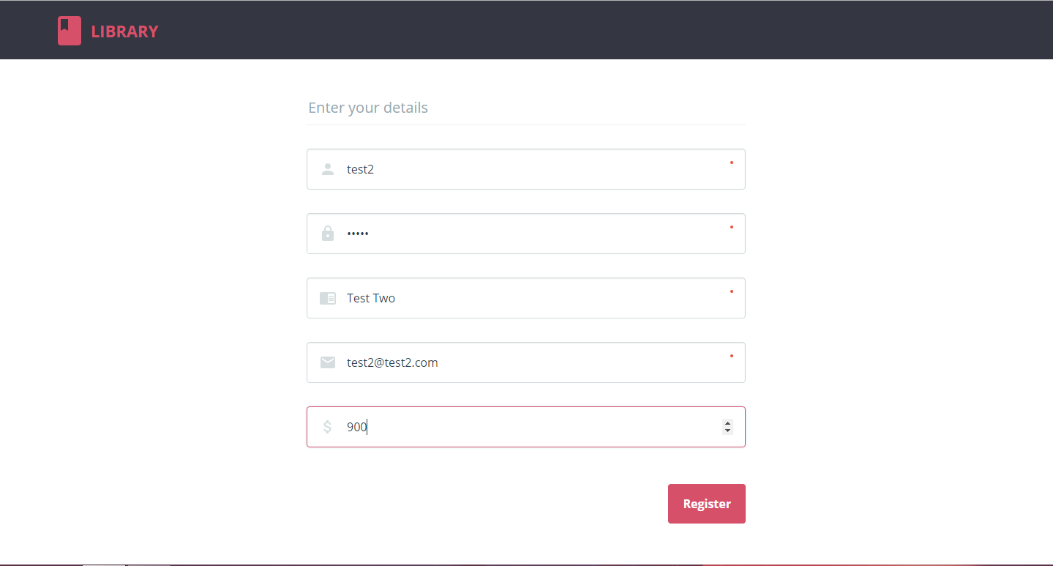
Fig: member registration2

Slide 14
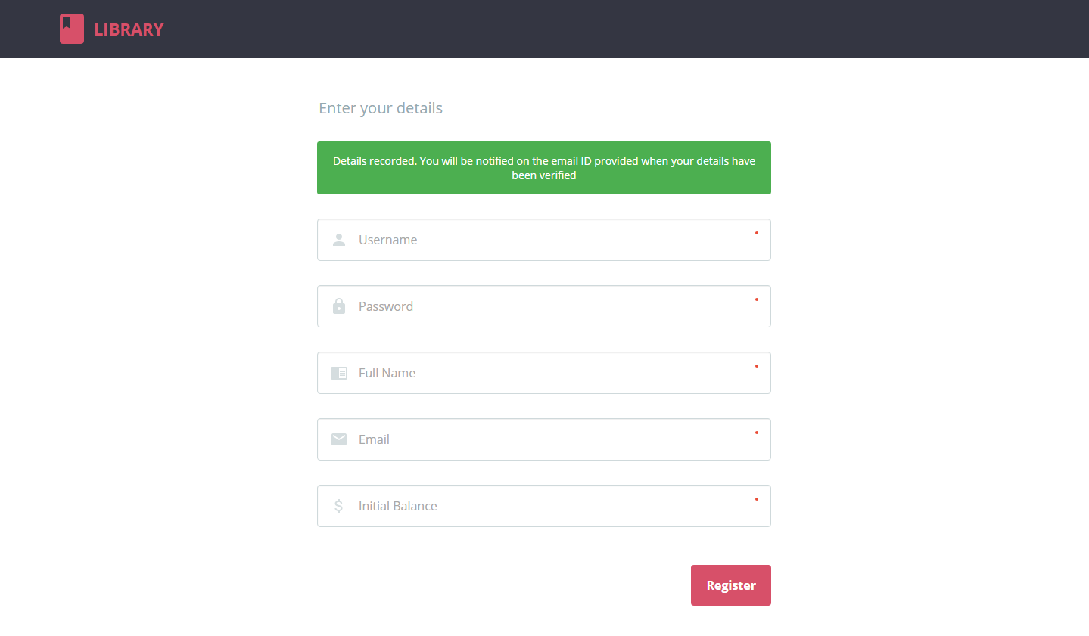
Fig: member registration3

Slide 15
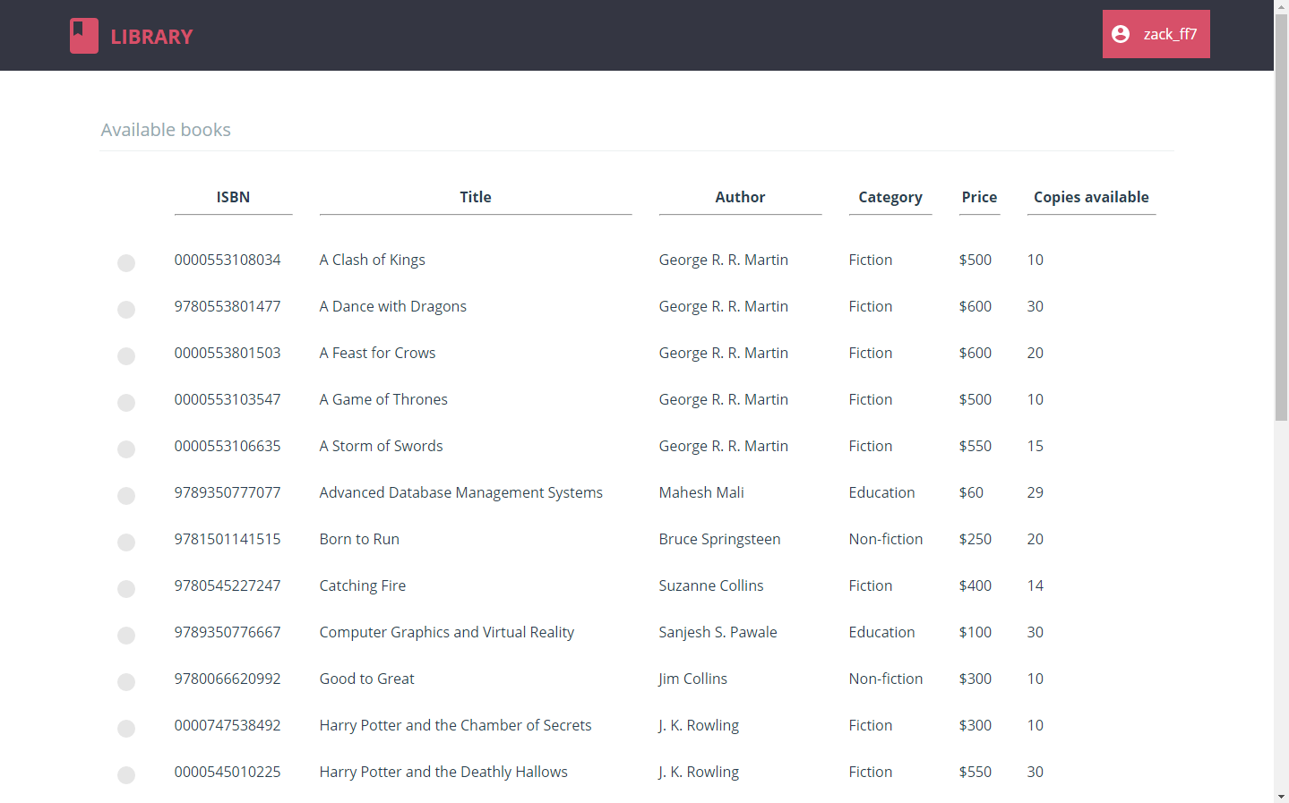
Fig: books1

Slide 16
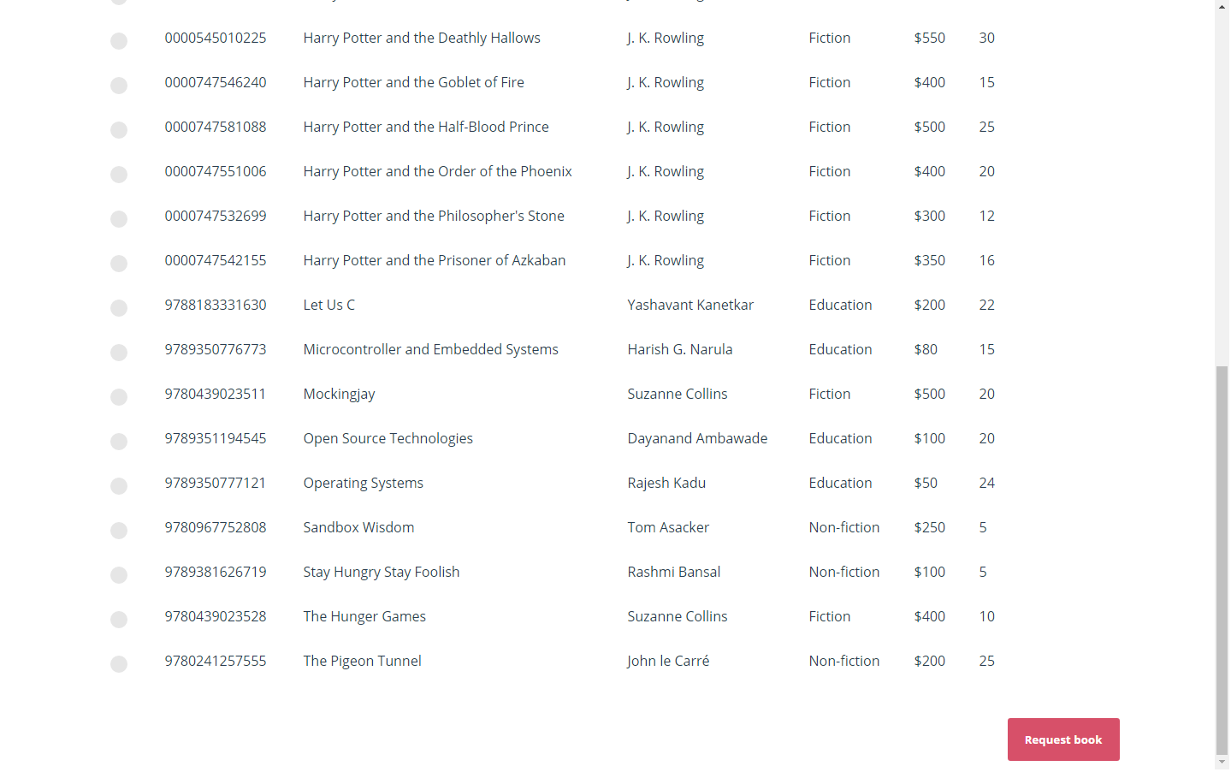
Fig: books2

Slide 17
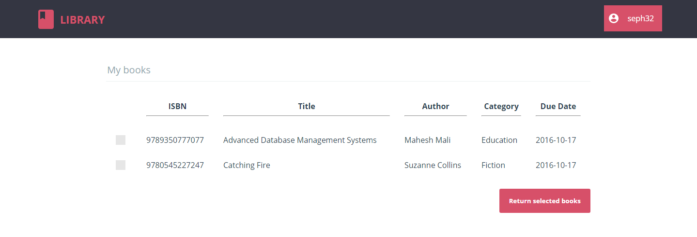
Fig: my books

Slide 18
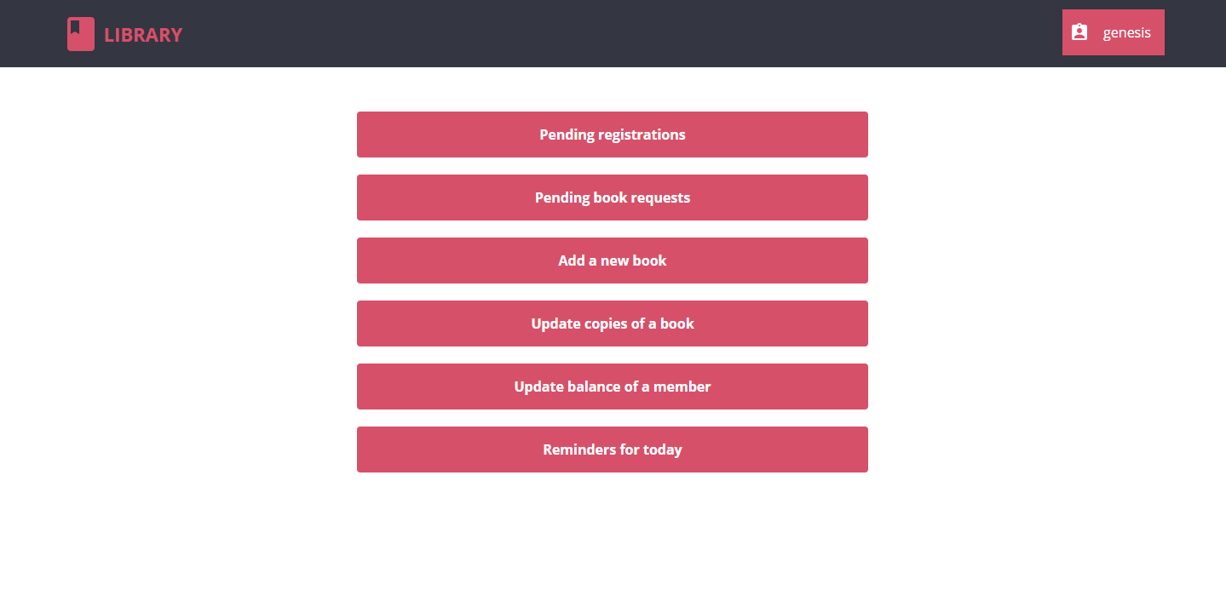
Fig: librarian home

Slide 19
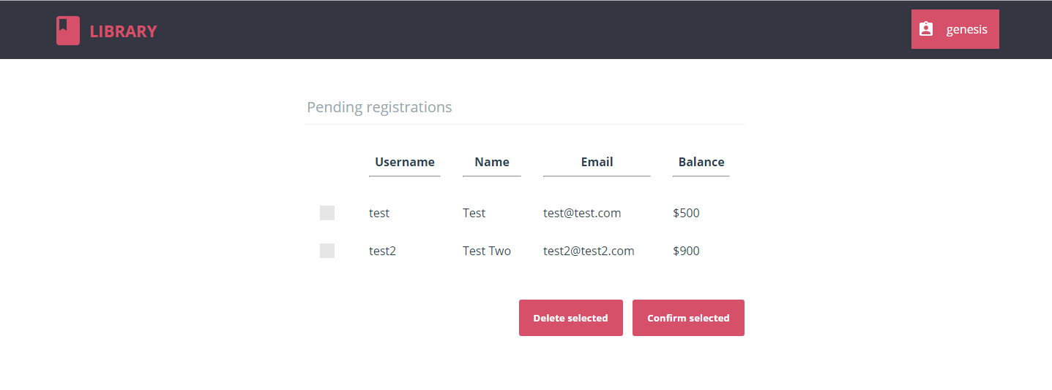
Fig: pending registrations

Slide 20
.
REFERENCES
BOOKS:
[1] Fundamentals Of Database Systems – by Ramez Elmarsi and Shamkant B. Navathe
[2] SQL Cookbook – by Anthony Molinaro
[3] PHP & MySQL Novice to Ninja – by Kevin Yank.
WEBSITES:
[1] www.w3schools.com.
[2] https://www.codecademy.com/learn/learn-php.
[3]www.tutorialspoint.com,.Available:https://www.tutorialspoint.com/system_analysis_and_design/system analysis_and_design_overview .html. [Accessed 25 04 2017].
[4] https://www.sourcecodesolutions.in/2010/09/library-management-system.html?m=1

